Slide 1
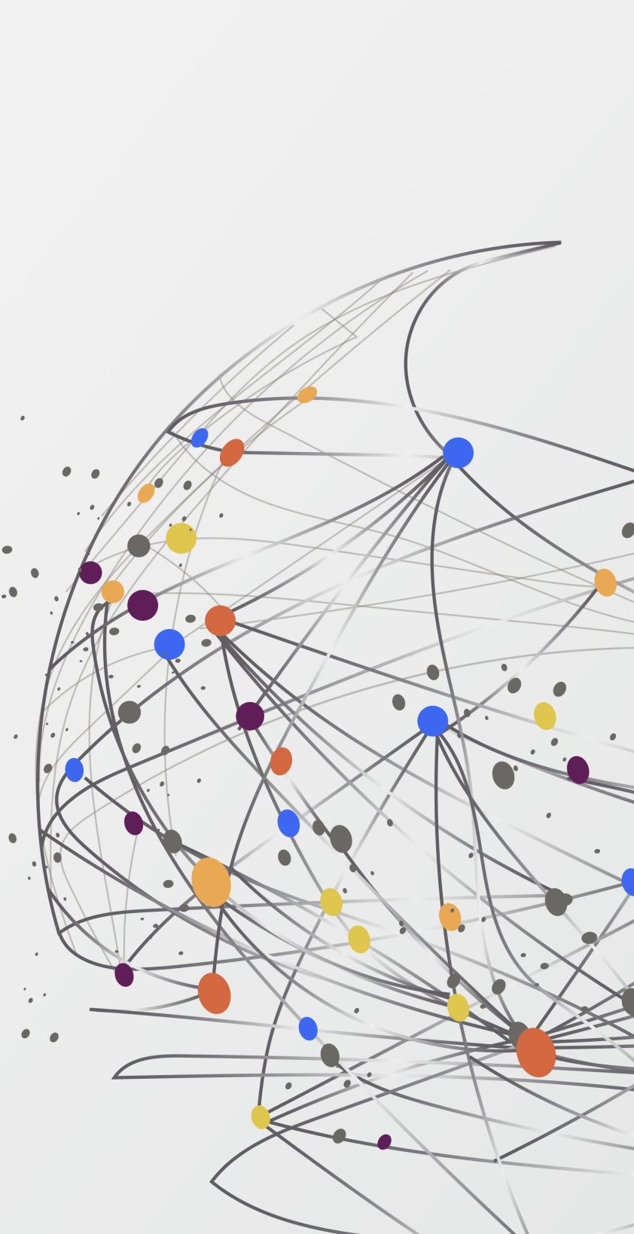
Vizualization
Project week 4 – Ironhack
Robin & tatiana

Slide 2
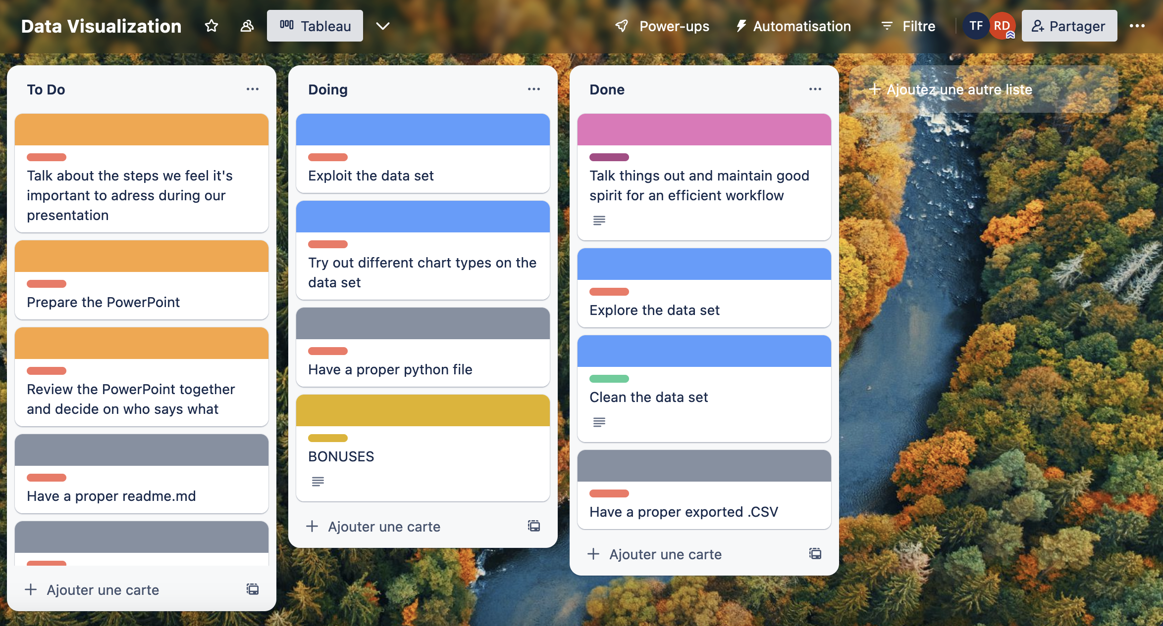
Process : Friday @ 1620 military time

Slide 3
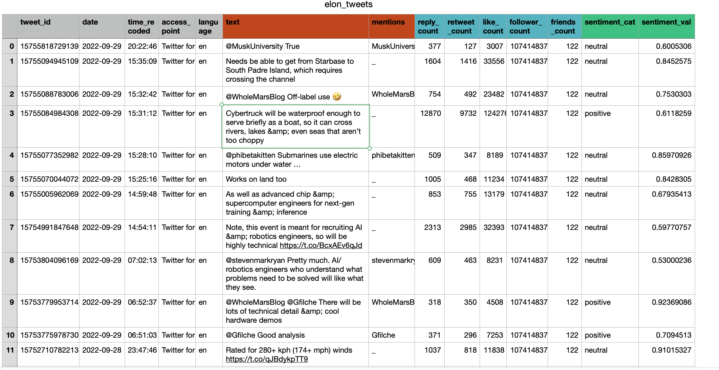
clean Dataset

Slide 4
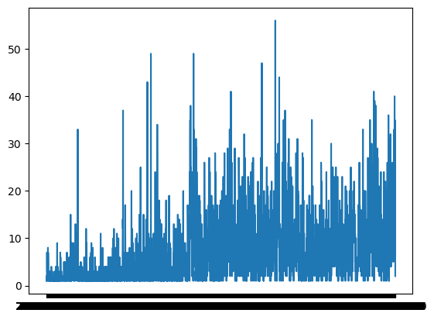
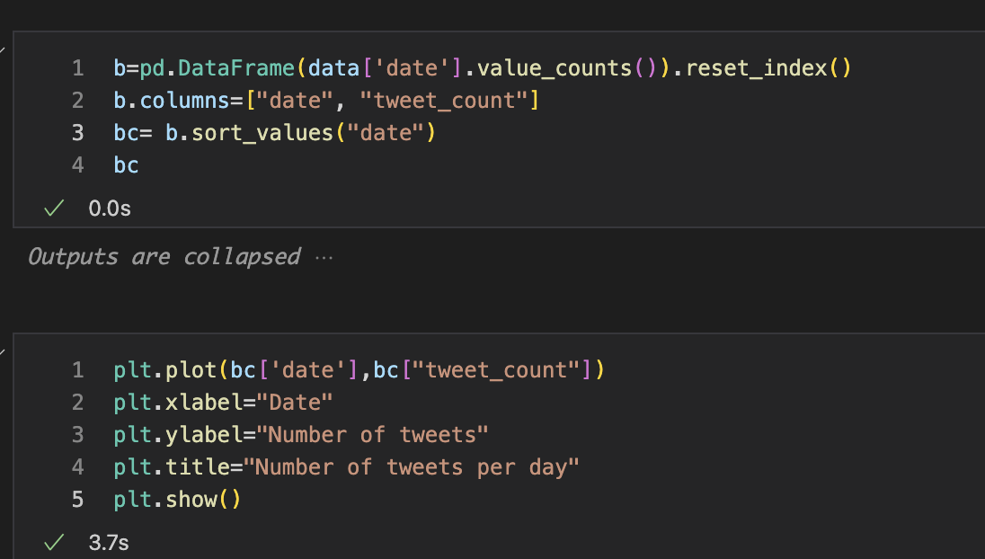
Tweet count over time

Slide 5
👋 Andy !

Slide 7
TWEET COUNT OVER TIME (2)

Slide 8
TWEET COUNT OVER TIME (3)

Slide 9
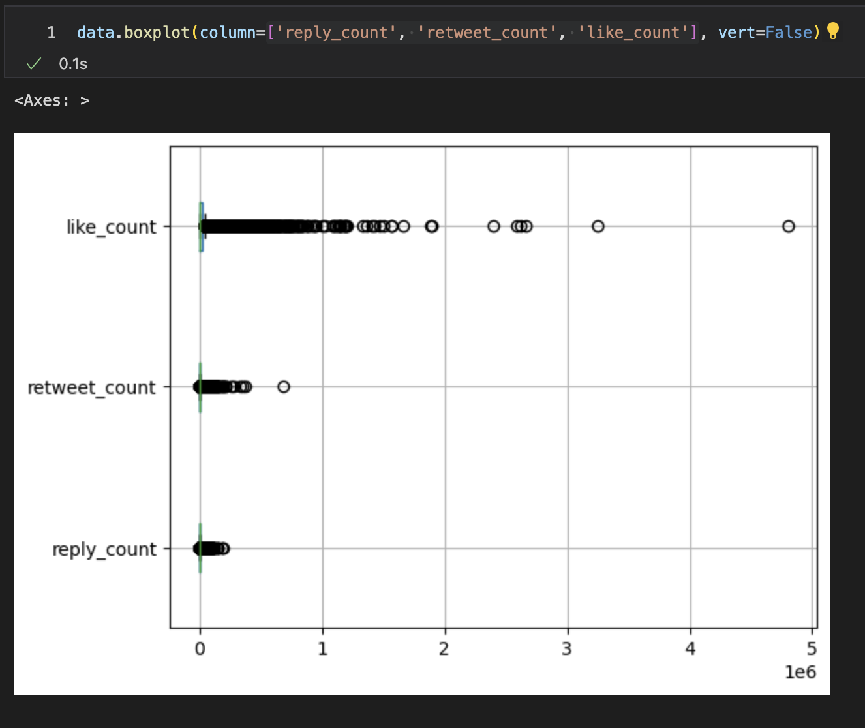
Tweet engagement rates distribution

Slide 10
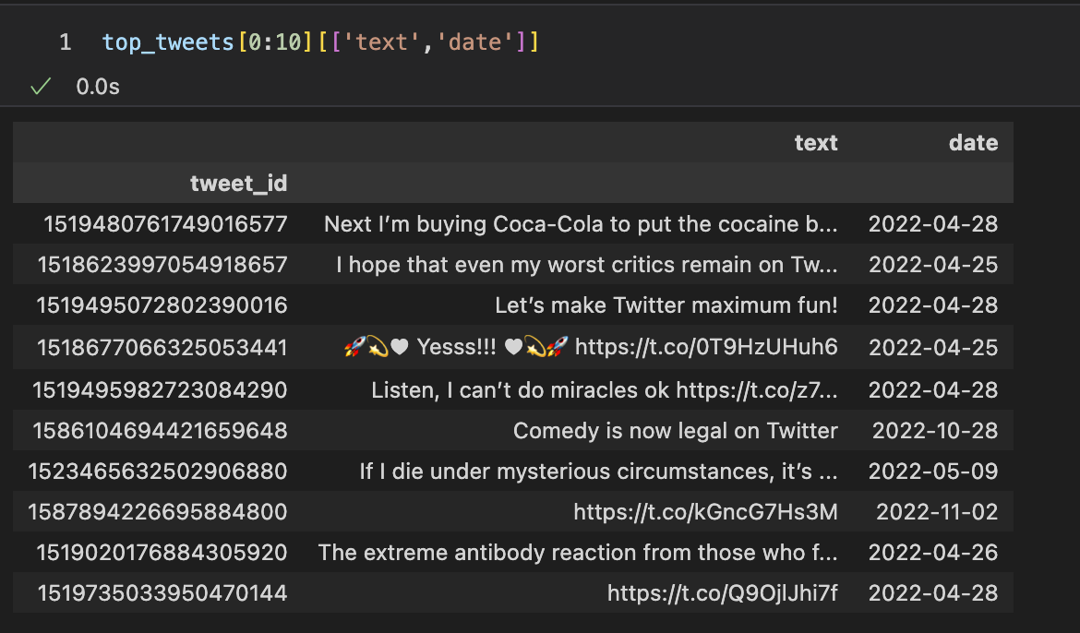
What are these top tweets that skew the data ?

Slide 11
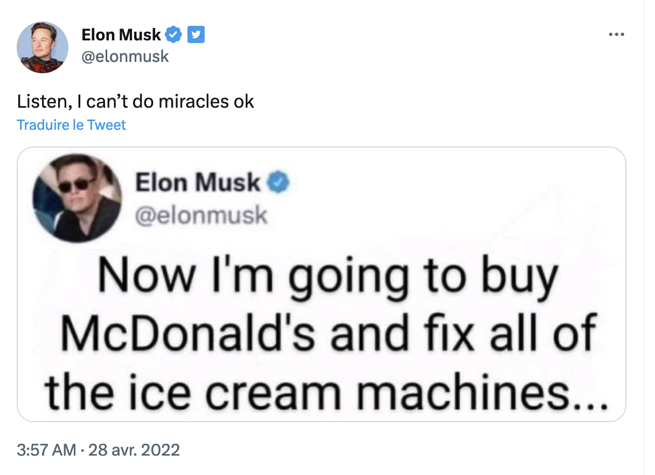
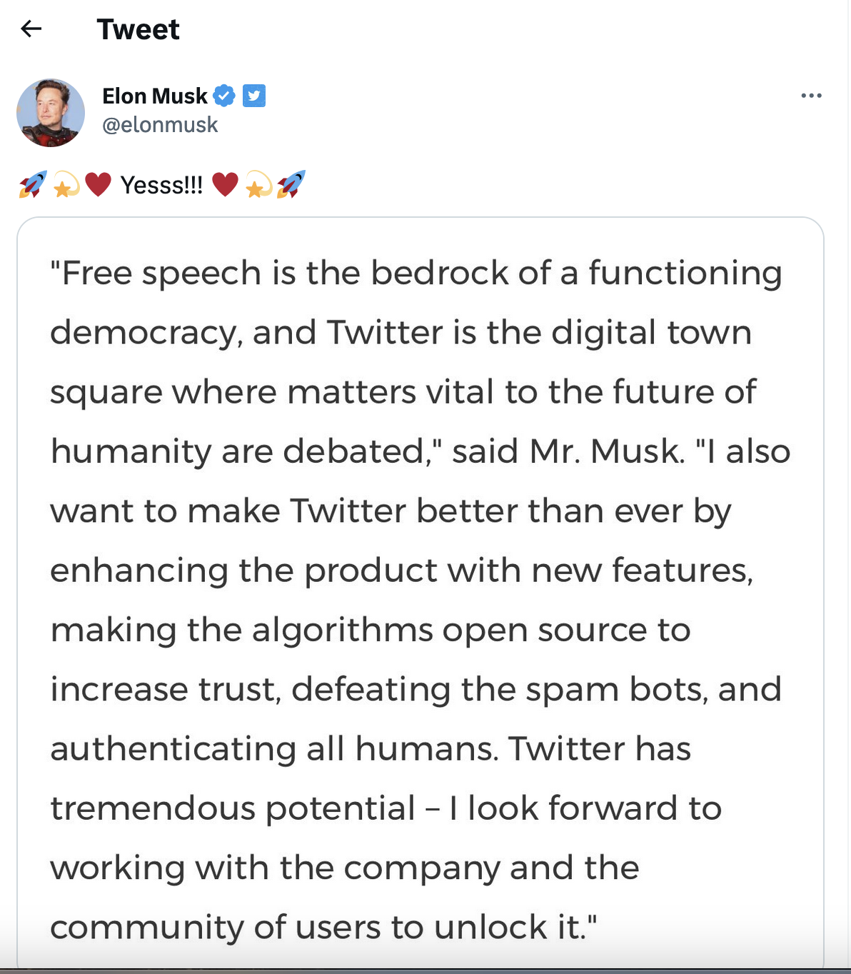
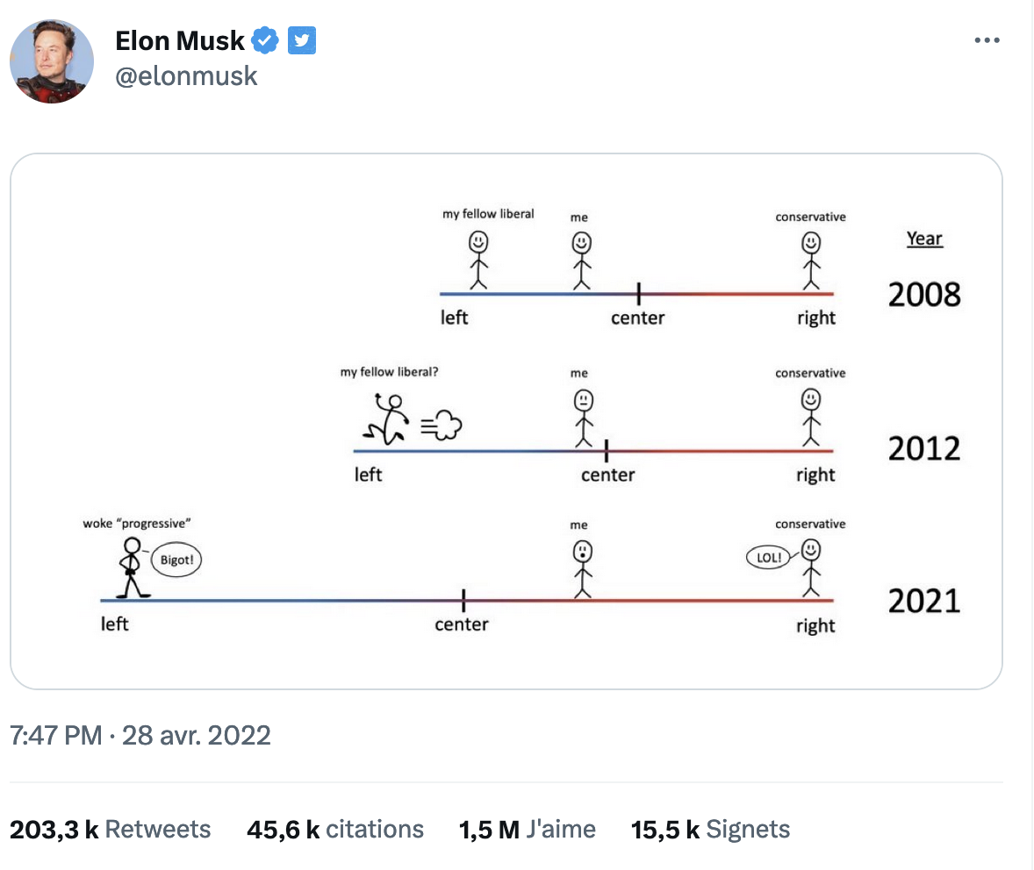
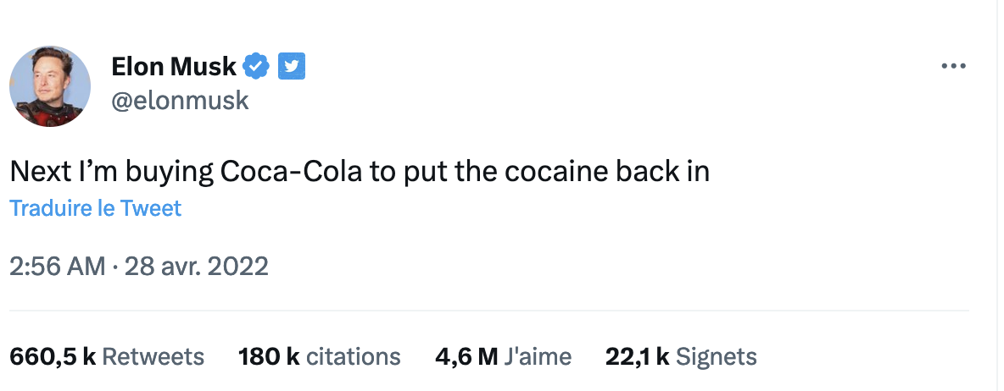
Our « flyers »
What happened
April 28,
2022 ?

Slide 12
Tweet engagement rates distribution (without outliers)
Notes:
We notice the scales against which we are measuring likes, RT and reply are not the same, but it's ok, because these measures are highly correlated.

Slide 13

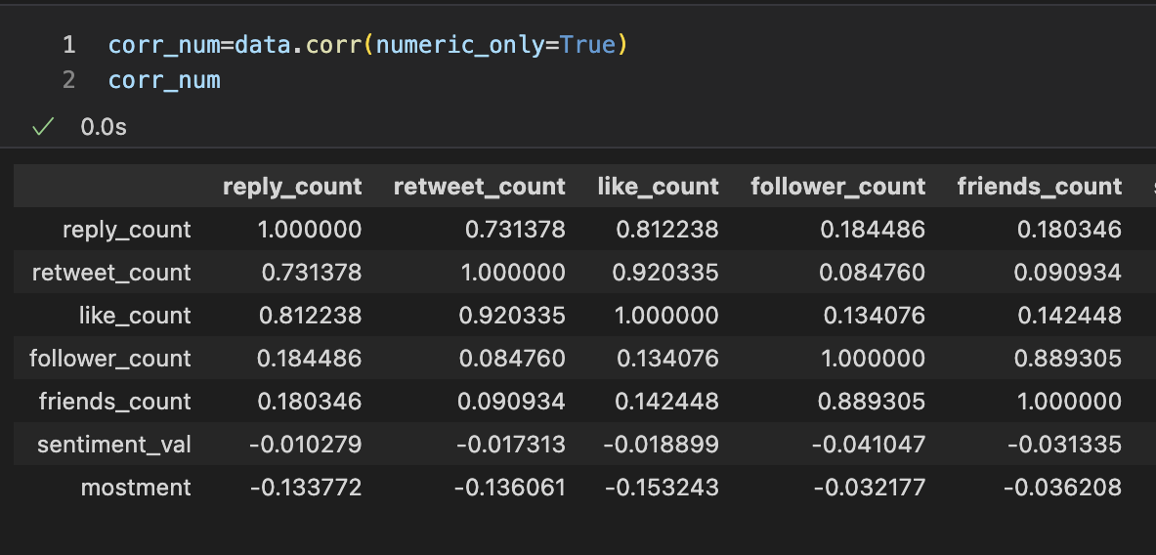
Counts of likes, RT, replies are correlated

Slide 14
Another way to represent correlation

Slide 15
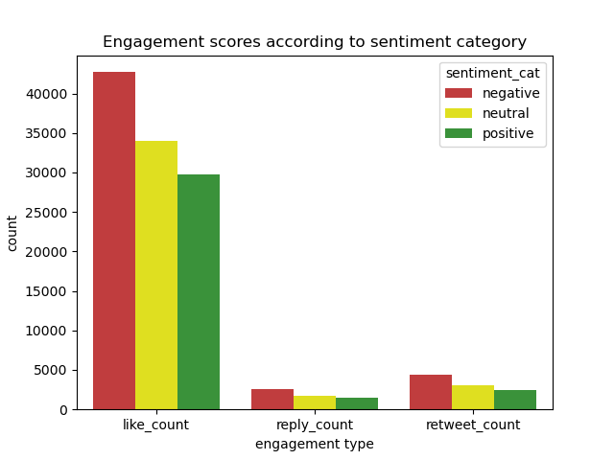
DOES TONE MATTER ?

Slide 16
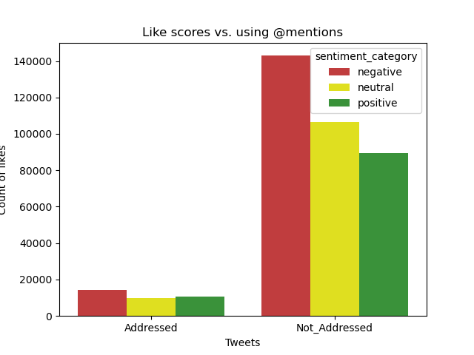
Does addressing matter ?

Slide 17
Even the ones you mention all the time ?

Slide 18
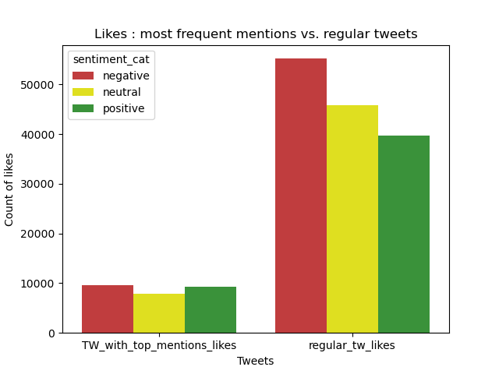
Even the ones you mention all the time ?

